Slide 1

Healthcare Data Mining for Disease Prediction
Name:Amrita Arun Hima Harshitha
Bhargavi Course Code & Name: CSA1606- Data Warehousing and Data Mining
Faculty name: Dr.S Renuga

Slide 2


INTRODUCTION
The Clinical Prediction System is an AI-powered healthcare web application developed for disease prediction based on patient symptoms.
The system uses Machine Learning algorithms such as Random Forest, KNN, and Logistic Regression for accurate disease analysis.
It provides features like appointment booking, email confirmation, and PDF appointment slip generation for patients.
The main aim of the project is to provide quick preliminary health predictions and simplify hospital appointment management.

Slide 3

OBJECTIVE
To develop an AI-based healthcare prediction system. To predict diseases using Machine Learning algorithms. To compare Random Forest, KNN, and Logistic Regression accuracies. To provide appointment booking with hospital and doctor selection. To maintain patient appointment history securely using a database. To generate graphical confidence analysis and downloadable PDF reports.

Slide 4
LITERATURE REVIEW
Paper Title | Authors | Year | Methodology | Demerits | Findings
Disease Prediction Using Machine Learning Algorithms | R.Kumar | 2021 | Used Random Forest, KNN, and Logistic Regression algorithms to predict diseases based on patient symptoms. | Lower accuracy for wrong inputs. | Random Forest gave better accuracy.
Smart Healthcare Appointment Management System | S.Priya | 2023 | Developed a web-based healthcare system with appointment booking, email notifications, and patient management features. | No AI prediction support. | Improved appointment scheduling.
AI-Based Clinical Assistance System for Patients | M.Arun Kumar | 2023 | Implemented AI-based disease prediction with voice assistance and graphical analysis for healthcare support. | Depends on dataset quality. | Provided faster health guidance.

Slide 5

PROBLEM STATEMENT
Traditional healthcare systems require more time for disease identification and appointment scheduling. Patients often face delays in consultation and limited access to preliminary medical guidance. Existing healthcare systems lack intelligent disease prediction and digital healthcare support. Many systems do not include features like graphical analysis, and automated confirmations.

Slide 6
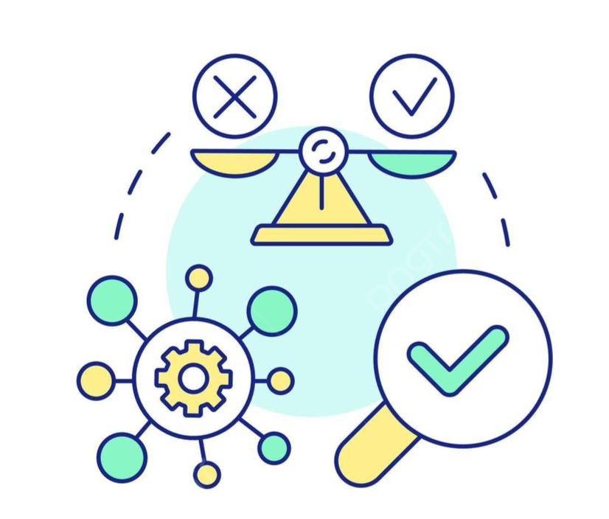
PROPOSED SOLUTION
The proposed system is a web-based Clinical Prediction platform that predicts diseases based on symptoms entered by patients. The system trains multiple Machine Learning algorithms for disease prediction. It automatically selects the best-performing model and displays prediction confidence. The platform provides disease prevention recommendations for patients. It allows appointment booking with hospitals and doctors, along with appointment confirmation emails. The system generates PDF appointment slips

Slide 7
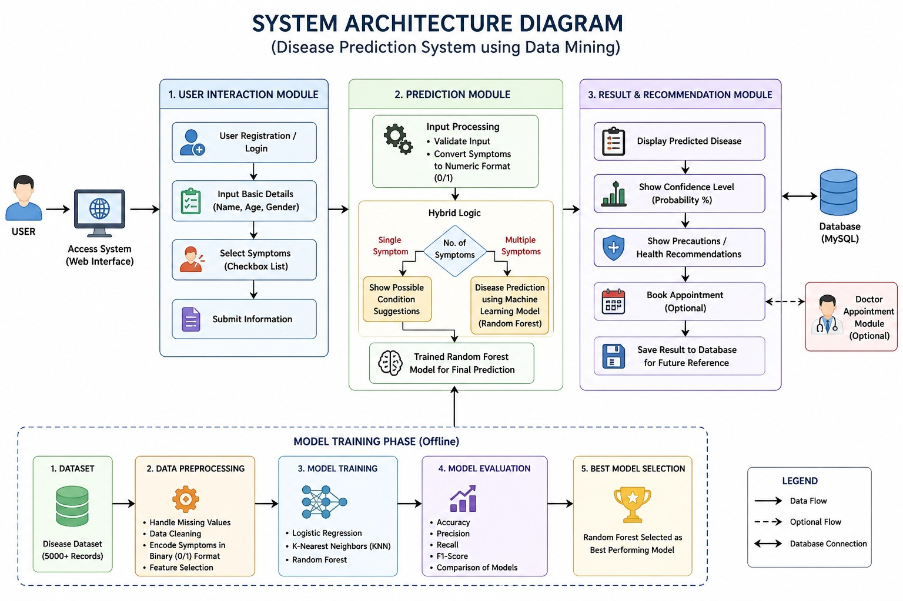
ARCHITECTURE

Slide 8
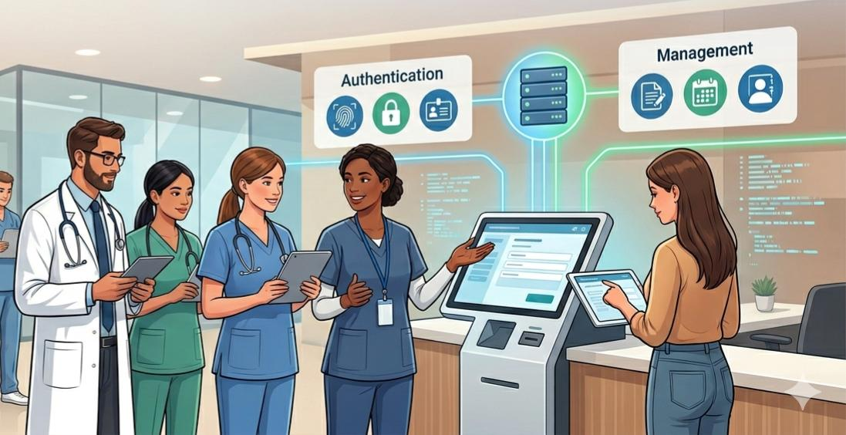
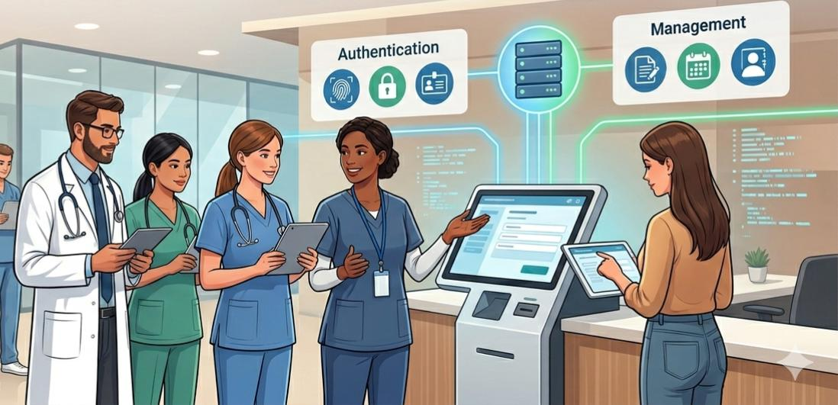
MODULE 1: PATIENT AUTHENTICATION AND MANAGEMENT
Provides secure patient registration and login functionality. Supports multiple patients using the same email with different usernames. Stores patient details securely using SQLite database. Includes password strength analysis for secure authentication.

Slide 9
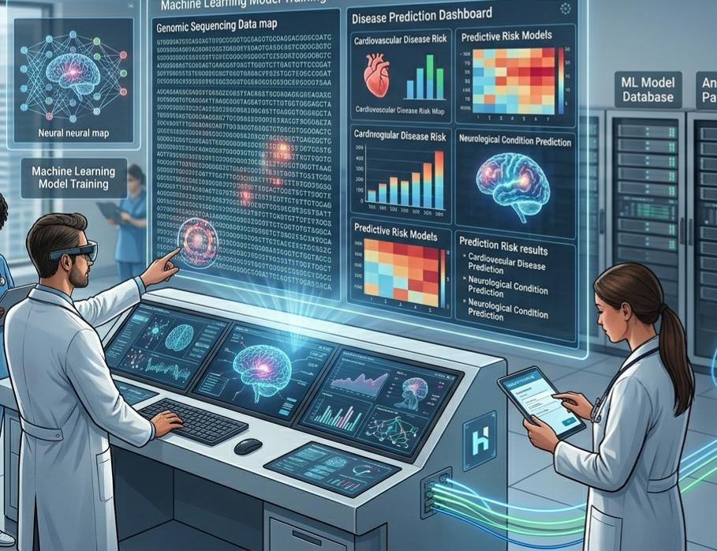
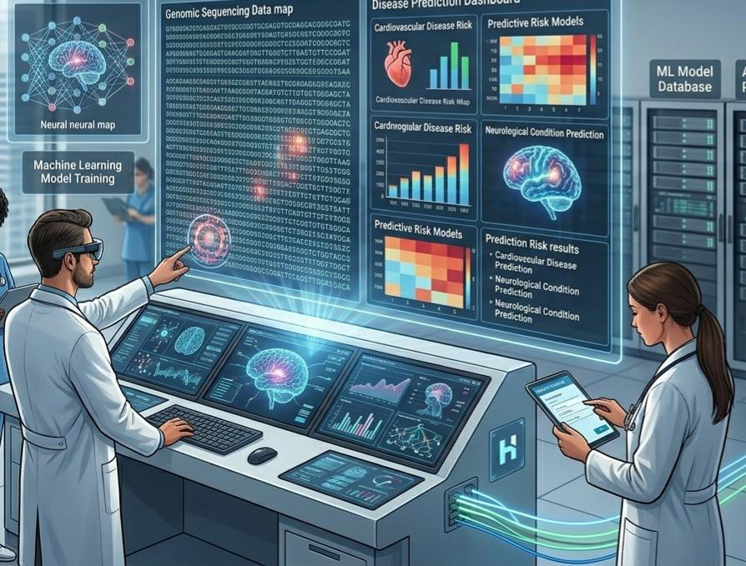
MODULE 2: DISEASE PREDICTION USING MACHINE LEARNING
Accepts patient symptoms and clinical details as input. Trains Random Forest, KNN, and Logistic Regression algorithms. Automatically selects the best model based on highest accuracy. Displays prediction confidence using graphical analysis. Generates disease prevention recommendations based on prediction.

Slide 10
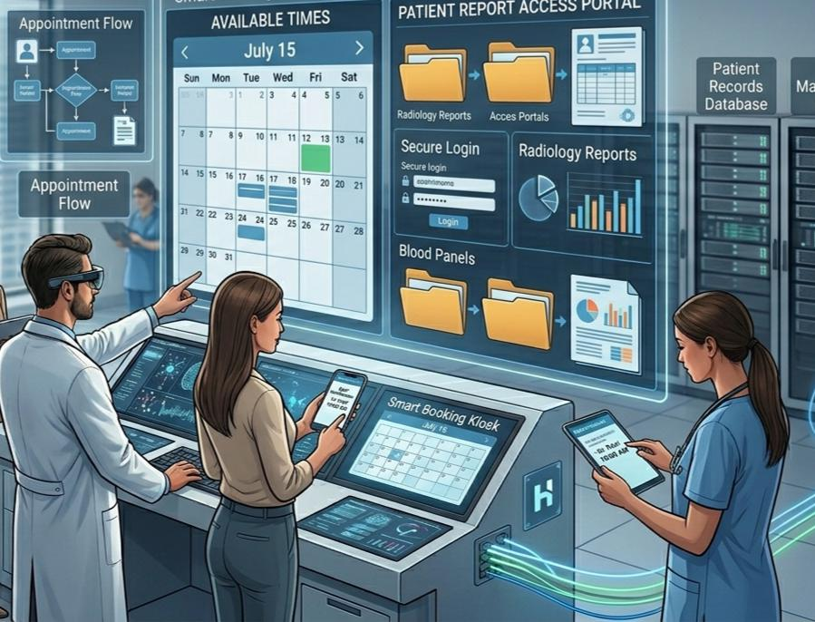
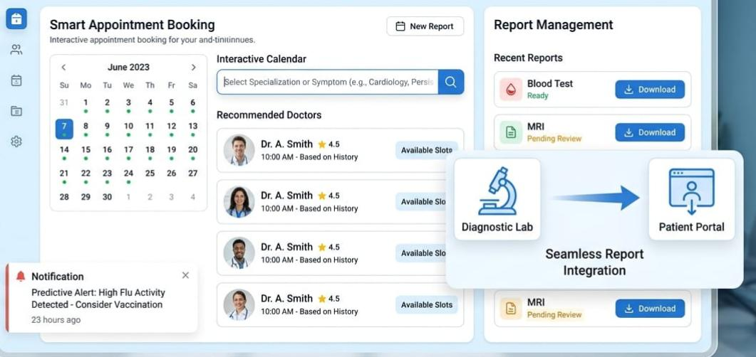
MODULE 3:SMART APPOINTMENT BOOKING AND
REPORT MANAGEMENT
Allows patients to select hospitals and doctors. Supports appointment scheduling with date and time selection. Sends appointment confirmation through email. Stores appointment history for future access. Generates downloadable PDF appointment reports.

Slide 11


FUTURE SCOPE
Integration with real hospital APIs. Live doctor availability tracking. AI chatbot for real-time medical assistance. Video consultation integration. Cloud database deployment for large-scale healthcare management. Mobile application development. Integration with wearable healthcare devices

Slide 12
CONCLUSION
The Clinical Prediction System successfully combines Machine Learning and healthcare management into a single intelligent web application.
The system improves disease prediction efficiency, enhances patient accessibility, and automates appointment management. By integrating AI prediction models, graphical analysis, multilingual support, and secure database management, the project provides a modern and user-friendly healthcare solution suitable for future smart healthcare environments.

Slide 13
THANK YOU

